Slide 1
MACHINE Learning Operations (MLoPS)
Session 25-26

Slide 2
Learning Outcome
LO 1: Explain the fundamental of machine learning concept
LO 2: Interpret the distribution of dataset using regression method
LO 3: Experiment classification and clustering algorithm from given dataset

Slide 3
Outline
Introduction to MLOps
Machine Learning Lifecycle Overview
MLOps Tools and Technologies
CI/CD for ML
Model Monitoring and Governance

Slide 4
Introduction to MLOps

Slide 5
Introduction to MLOPS
Understanding MLOps and its significance
MLOps, short for Machine Learning Operations, is a set of practices that aim to streamline and automate the end-to-end machine learning lifecycle. It encompasses the entire process from data preparation and model development to deployment, monitoring, and maintenance in production environments.
MLOps addresses the challenges of deploying and managing machine learning models at scale. It promotes collaboration between data scientists, developers, and operations teams, ensuring the efficient and reliable delivery of machine learning solutions. MLOps enhances the reproducibility, scalability, and maintainability of ML projects.

Slide 6
Introduction to MLOPS
Key differences between traditional software development and MLOps
Aspect | Traditional Software Development | MLOps
Objective | Develop and maintain software applications | Deploy and manage machine learning models in production
Development Lifecycle | Linear, often following methodologies like SDLC | Iterative and experimental, reflecting the ML lifecycle
Data Dependency | Emphasis on code; less focus on data management | Strong emphasis on managing and versioning data
Nature of Work | Code-centric, with clear specifications and requirements | Data-centric, involving exploration and experimentation
Testing and Validation | Rigorous testing of code and software functionalities | Testing involves both code and model evaluation, with a focus on model performance
Reproducibility | Code versioning is standard for reproducibility | Requires versioning of both code and data for reproducibility
Model Deployment | Traditional deployment strategies (e.g., web servers) | Specialized deployment processes for machine learning models
Continuous Integration and Deployment (CI/CD) | CI/CD pipelines for code deployment | CI/CD pipelines include model training, testing, and deployment stages

Slide 7
Introduction to MLOPS
Key differences between traditional software development and MLOps
Aspect | Traditional Software Development | MLOps
Monitoring | Monitoring focuses on software performance and errors | Extensive monitoring of model performance, data drift, and other ML-specific metrics
Collaboration | Collaboration among developers and operations teams | Cross-functional collaboration involving data scientists, developers, and operations
Learning and Adaptation | Rarely adaptive after deployment | Recognizes the need for continuous learning and adaptation as models operate in dynamic environments
Scale and Resource Management | Traditional considerations for server scalability | Requires scaling strategies for handling large-scale model inference
Security | Standard security practices for applications | Specialized security considerations for machine learning models and data
Documentation | Comprehensive code documentation | Requires documentation for both code and data processes

Slide 8
Machine Learning Lifecycle Overview

Slide 9
Machine Learning Lifecycle Overview
Exploring the stages of the machine learning lifecycle
Problem Definition
Data Collection and Preparation
Feature Engineering
Model Training
Model Evaluation
Model Deployment

Slide 10
Machine Learning Lifecycle Overview
Challenges in each stage and the need for MLOps
Data Challenges:
Dealing with noisy or incomplete data.
Ensuring data quality and consistency across different sources.
Model Challenges:
Overfitting or underfitting during training.
Ensuring model interpretability and explainability.
Deployment Challenges:
Managing dependencies and versioning in a production environment.
Ensuring seamless integration with existing systems.
Monitoring Challenges:
Detecting concept drift and model degradation in real-time.
Establishing mechanisms for continuous monitoring and feedback loops.

Slide 11
MLOps Tools and Technologies

Slide 12
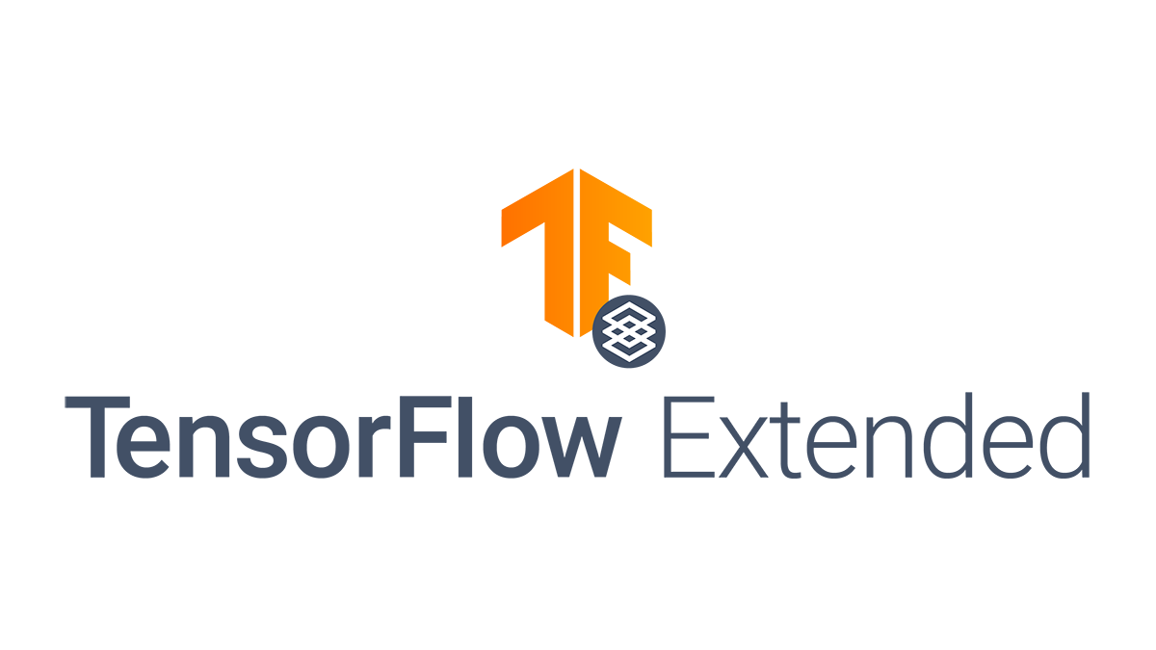

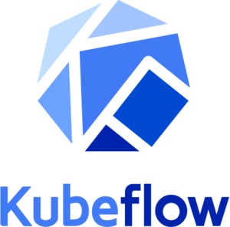
MLOps Tools and Technologies
Overview of popular MLOps tools
In the landscape of MLOps, various tools play crucial roles in different stages of the machine learning lifecycle. Understanding these tools is essential for creating efficient and scalable ML workflows.

Slide 13
MLOps Tools and Technologies
Overview of popular MLOps tools
TensorFlow Extended (TFX):
TensorFlow Extended, or TFX, is an end-to-end platform developed by Google for deploying production-ready machine learning models. It encompasses various components that address different aspects of the ML pipeline:
TFX Components:
ExampleGen: Ingests and imports datasets for training.
StatisticsGen: Computes and analyzes dataset statistics.
SchemaGen: Examines and defines the dataset schema.
ExampleValidator: Identifies and handles anomalies in the dataset.
Transform: Preprocesses and transforms data for training.
Trainer: Builds and trains the machine learning model.
Tuner: Optimizes hyperparameters.
InfraValidator: Validates the model for serving.

Slide 14
MLOps Tools and Technologies
Overview of popular MLOps tools
MLflow:
MLflow is an open-source platform designed to manage the end-to-end machine learning lifecycle. It comprises several components to streamline the ML workflow:
MLflow Tracking: Enables experiment tracking and management.
MLflow Projects: Organizes and packages code into reproducible runs.
MLflow Models: Manages and deploys models in different formats.
MLflow Registry: Stores and organizes models for collaboration.

Slide 15
MLOps Tools and Technologies
Overview of popular MLOps tools
Kubeflow:
Kubeflow is a Kubernetes-native platform that provides a set of tools for building and deploying scalable and portable ML workflows. Key components include:
Kubeflow Pipelines: Facilitates the orchestration of machine learning workflows.
Katib: Handles hyperparameter tuning.
KFServing: Supports the deployment, serving, and scaling of ML models.

Slide 16
MLOps Tools and Technologies
Understanding version control for machine learning models
Introduction to Version Control
Version control is crucial for managing ML projects.
It tracks changes, enables collaboration, and maintains reproducibility.
ML projects involve code, data, and model artifacts.

Slide 17
MLOps Tools and Technologies
Understanding version control for machine learning models
Versioning Data and Models
Versioning ensures tracking changes over time for data and model artifacts.
It includes training data, preprocessed data, and feature engineering scripts.
Versioning models is critical for reproducibility and performance assessment.

Slide 18
MLOps Tools and Technologies
Understanding version control for machine learning models
Git for ML Projects
Git is a distributed version control system widely used in ML.
It manages repositories, supports branching, and handles merges.
Git tracks changes in code, data, and model files for collaboration and experimentation.

Slide 19
MLOps Tools and Technologies
Understanding version control for machine learning models
Model Registry
A model registry is a repository for organizing and tracking model versions.
It manages metadata, facilitates comparisons, and aids in model retrieval.
Tools and platforms support model registry functionality in ML workflows.

Slide 20
MLOps Tools and Technologies
Understanding version control for machine learning models
Best Practices and Challenges
Best practices include clear commit messages, documentation, and collaborative workflows.
Challenges include versioning large datasets, handling binary files, and integrating with ML pipelines.
The section emphasizes the importance of effective version control for ML project success.

Slide 21
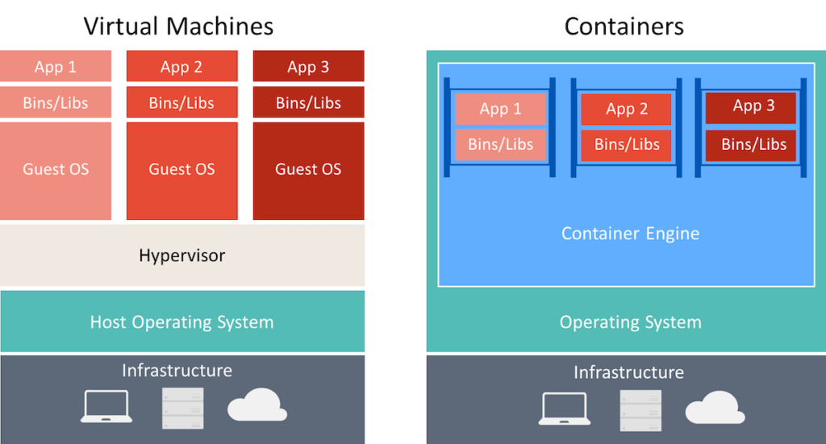
MLOps Tools and Technologies
Containerization and orchestration for scalable deployments
Containerization is a lightweight, portable, and reproducible packaging approach for software applications, and Docker is a widely used tool for creating and managing containers. In the context of MLOps, containerization plays a crucial role in ensuring that machine learning models and their dependencies can be packaged together, providing consistency across different environments.

Slide 22
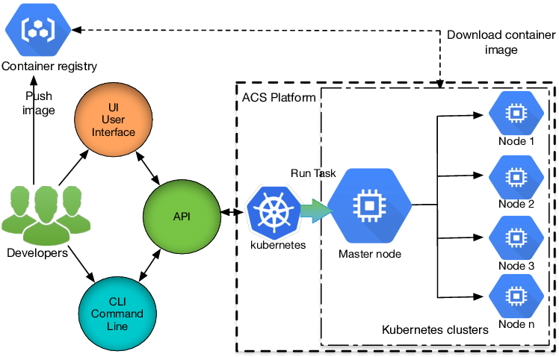
MLOps Tools and Technologies
Containerization and orchestration for scalable deployments
Orchestration with Kubernetes

Slide 23
CI/CD for ML

Slide 24
CI/CD for ML
Implementing CI/CD pipelines for machine learning projects
CI/CD practices aim to automate and streamline the process of integrating code changes, testing them, and deploying them to production. In the context of machine learning, CI/CD is crucial for maintaining model consistency, testing model updates, and ensuring rapid deployment.
Key Concepts
Automated Testing: Integration of automated testing for model training scripts, ensuring that changes do not break existing functionality.
Versioning: Managing version control not only for code but also for datasets and model artifacts.
Continuous Integration: Automatically building and validating models whenever there is a code change, ensuring that the integration of new features does not introduce errors.
Continuous Deployment: Automating the deployment process to move models seamlessly from development to staging and production environments.

Slide 25
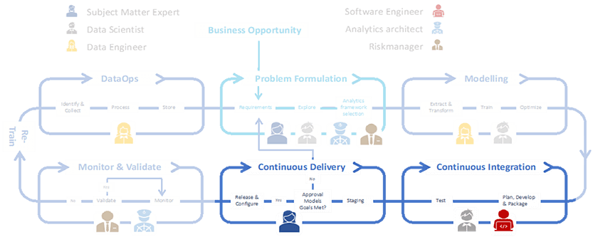
CI/CD for ML
Implementing CI/CD pipelines for machine learning projects

Slide 26
CI/CD for ML
Versioning and tracking model artifacts
Version control is essential for managing the evolution of machine learning models. This includes tracking changes in code, datasets, and model artifacts to reproduce experiments, ensure reproducibility, and troubleshoot issues.
Code Versioning: Using version control systems (e.g., Git) for tracking changes in code, enabling collaboration, and maintaining a history of modifications.
Dataset Versioning: Managing versions of datasets to maintain consistency in training and evaluation.
Model Artifact Versioning: Tracking versions of trained models, including metadata and hyperparameters.

Slide 27
Model Monitoring and Governance

Slide 28
Model Monitoring and Governance
Importance of monitoring machine learning models in production
Overview
Monitoring machine learning models in production is crucial to ensure their continued effectiveness and reliability. This involves tracking various metrics, data drift, and model performance over time.
Key Concepts
Metrics: Identifying and monitoring key performance indicators (KPIs) such as accuracy, precision, recall, and F1 score.
Data Drift: Recognizing shifts in the input data distribution that may impact model performance.
Model Drift: Monitoring the degradation of model performance over time due to changes in the underlying data or external factors.
Tools and Techniques
Implementing automated monitoring tools that provide real-time insights into model behavior.
Setting up alerts and notifications for anomalous behavior.
Utilizing statistical methods to detect data drift and model degradation.

Slide 29
Model Monitoring and Governance
Metrics and key performance indicators for model health
Choosing Appropriate Metrics
Selecting metrics that align with the specific goals of the machine learning project (e.g., accuracy for classification, mean squared error for regression).
Understanding the trade-offs between different metrics and the impact on business objectives.
Interpretable Models
Exploring metrics that facilitate interpretability, such as feature importance and SHAP values.
Balancing interpretability with model complexity and performance.
Model Explainability
Evaluating model explainability methods to enhance understanding and trust in model predictions.
Incorporating explainability metrics as part of the overall monitoring strategy.

Slide 30
Model Monitoring and Governance
Implementing model governance and compliance
Introduction to Model Governance
Definition and Significance: Model governance refers to the set of processes, policies, and controls put in place to manage the lifecycle of machine learning models. It ensures that models are developed, deployed, and maintained in a systematic and compliant manner.
Lifecycle Management: Understanding the various stages of a model's lifecycle—from development to retirement—and establishing governance protocols for each stage.
Risk Management: Identifying and mitigating risks associated with model deployment, including issues related to performance, security, and ethical considerations.

Slide 31
Model Monitoring and Governance
Implementing model governance and compliance
Ethical Considerations
Bias and Fairness: Addressing concerns related to bias in machine learning models and ensuring fairness in predictions across different demographic groups. This involves assessing and mitigating biases present in training data and model outputs.
Transparency: Striving for transparency in model decision-making processes. This includes making efforts to interpret and communicate how a model arrives at its predictions, especially in applications where decisions impact individuals or communities.

Slide 32
Model Monitoring and Governance
Implementing model governance and compliance
Compliance and Regulations
Regulatory Landscape: Understanding the regulatory environment in which the model operates. This may include data protection laws (e.g., GDPR), industry-specific regulations (e.g., HIPAA for healthcare), and standards set by regulatory bodies.
Legal and Ethical Compliance: Developing models and processes that align with legal and ethical standards. This includes ensuring privacy, informed consent, and compliance with industry best practices.

Slide 33
Model Monitoring and Governance
Implementing model governance and compliance
Documentation and Auditing
Comprehensive Documentation: Maintaining thorough documentation throughout the model development and deployment lifecycle. This includes documenting data sources, feature engineering steps, model architecture, and hyperparameters.
Versioning: Implementing version control for models to track changes over time. This allows for easy rollback in case of issues and facilitates auditing of model changes.
Auditing Processes: Establishing auditing mechanisms to track who accesses the models, when changes were made, and the impact of those changes. Audits contribute to accountability and transparency in model governance.

Slide 34
Model Monitoring and Governance
Implementing model governance and compliance
Implementation Strategies
Model Governance Frameworks: Exploring established frameworks and methodologies for model governance, such as the Model Development Lifecycle (MDLC) or the CRISP-DM (Cross-Industry Standard Process for Data Mining) framework.
Automation: Utilizing automation tools and platforms to enforce governance policies consistently. This includes automated checks for compliance, model monitoring, and alerting mechanisms.
Cross-Functional Collaboration: Promoting collaboration between data scientists, legal experts, compliance officers, and other stakeholders to ensure a holistic approach to model governance.

Slide 35
References

Slide 36
References
https://ml-ops.org/
https://fullstackdeeplearning.com/spring2021/lecture-6/
https://mlclass.ir/slides/MLOps.pdf
https://arxiv.org/abs/2102.07750
https://dl.acm.org/doi/abs/10.1145/3534678.3542604

